Slide 1
Implementation of SB 1383 and Engaging Your Students for Teachers
CalRecycle Staff
Notes:
Introduction - Opener

Slide 2
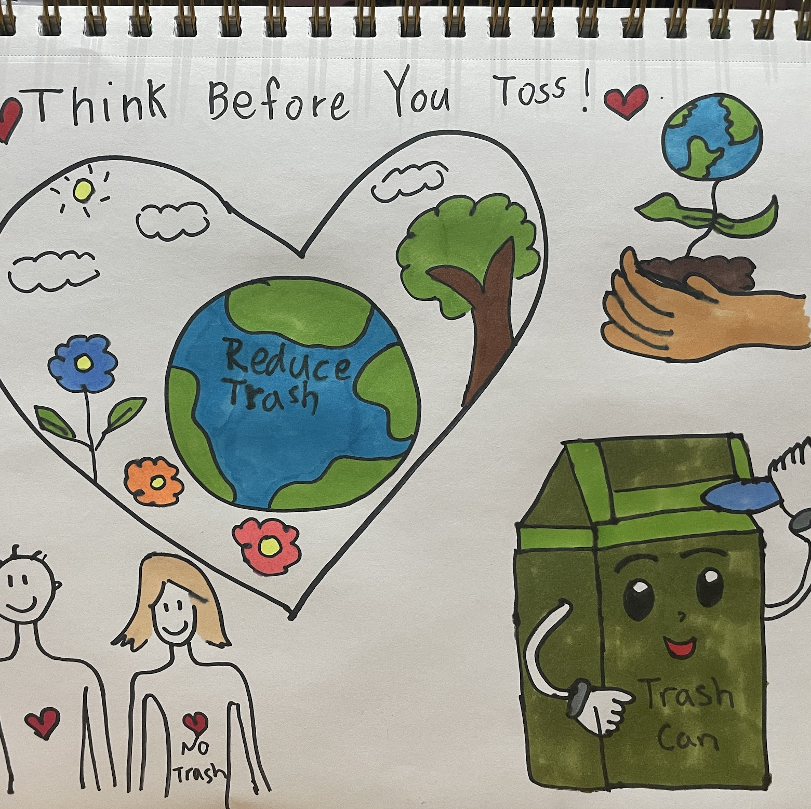
Resources for your role as a Teacher
Waste Sorting Videos for Students
Lesson Plans
Starting a School Green Team
Posters for the Classroom
Activity Booklets
Music Videos
Photo courtesy of OUSD
Notes:
Many individuals monitor school waste, including school district administrators concerned about increases in solid waste disposal costs, recycling-conscious teachers and students, and city/county recycling coordinators working with a local school districts.
There are a number of recycling laws that affect school districts and schools that I will briefly touch on before diving into the SB 1383, which builds on these regulations' requirements:
Mandatory Commercial Recycling, impacting schools that generate at least 4 cubic yards of municipal solid waste per week.
Mandatory Commercial Organics Recycling, impacting schools that generate 2 cubic yards of solid waste per week, that is 2 cubic yards of trash, recycling, and organics total.

Slide 3
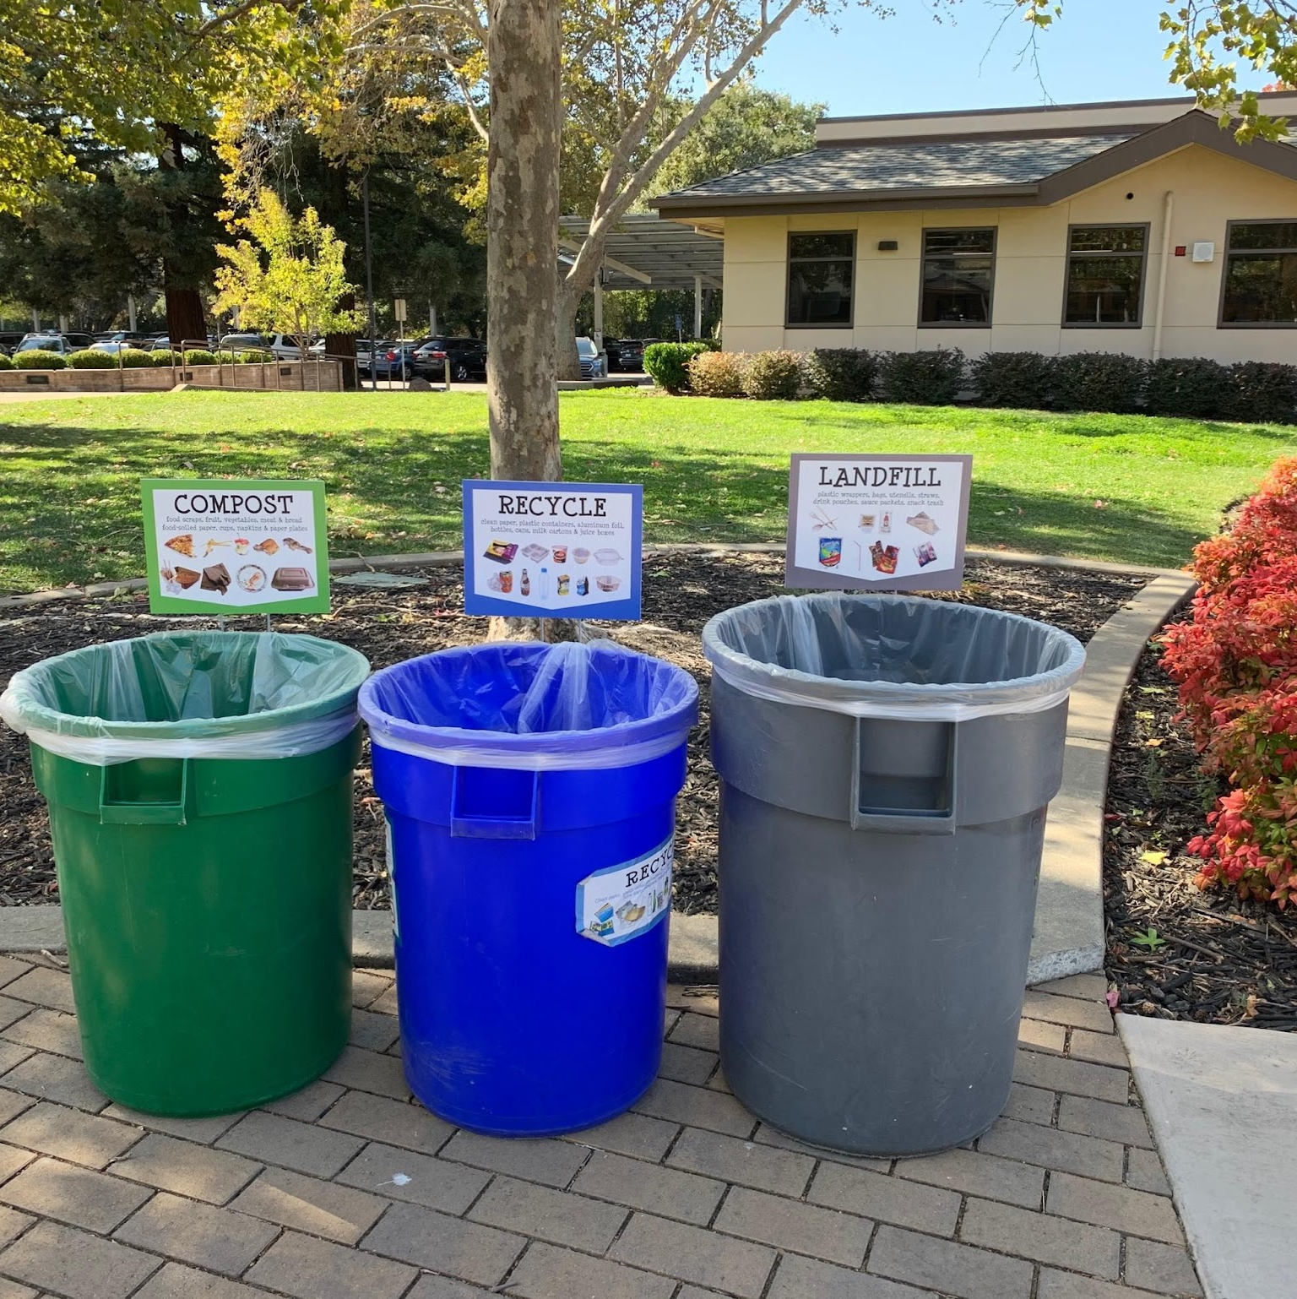
Waste Sorting Videos for Various Grades
Middle / High / Staff Level Waste Sorting (4 min)
Middle + High School In Depth Waste Sorting (15 min)
K-5 Level Waste Sorting (15 min)
Pre-K Waste Sorting (4 min)
Staff Waste Sorting (15 min)
Waste Sorting Music Video Playlist
Photo courtesy of OUSD

Slide 4
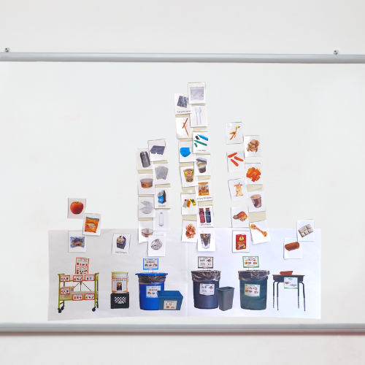
Lesson Plans + Activity Booklets
OUSD Waste Sorting
101 Lesson (K-5)
K-3rd, 4th, 5th-High School Lesson Plans
Oakland Recycles Activity Book

Slide 5
Online Games for Engagement: Kahoot
Kahoot! Game Guide
Coming Soon

Slide 6
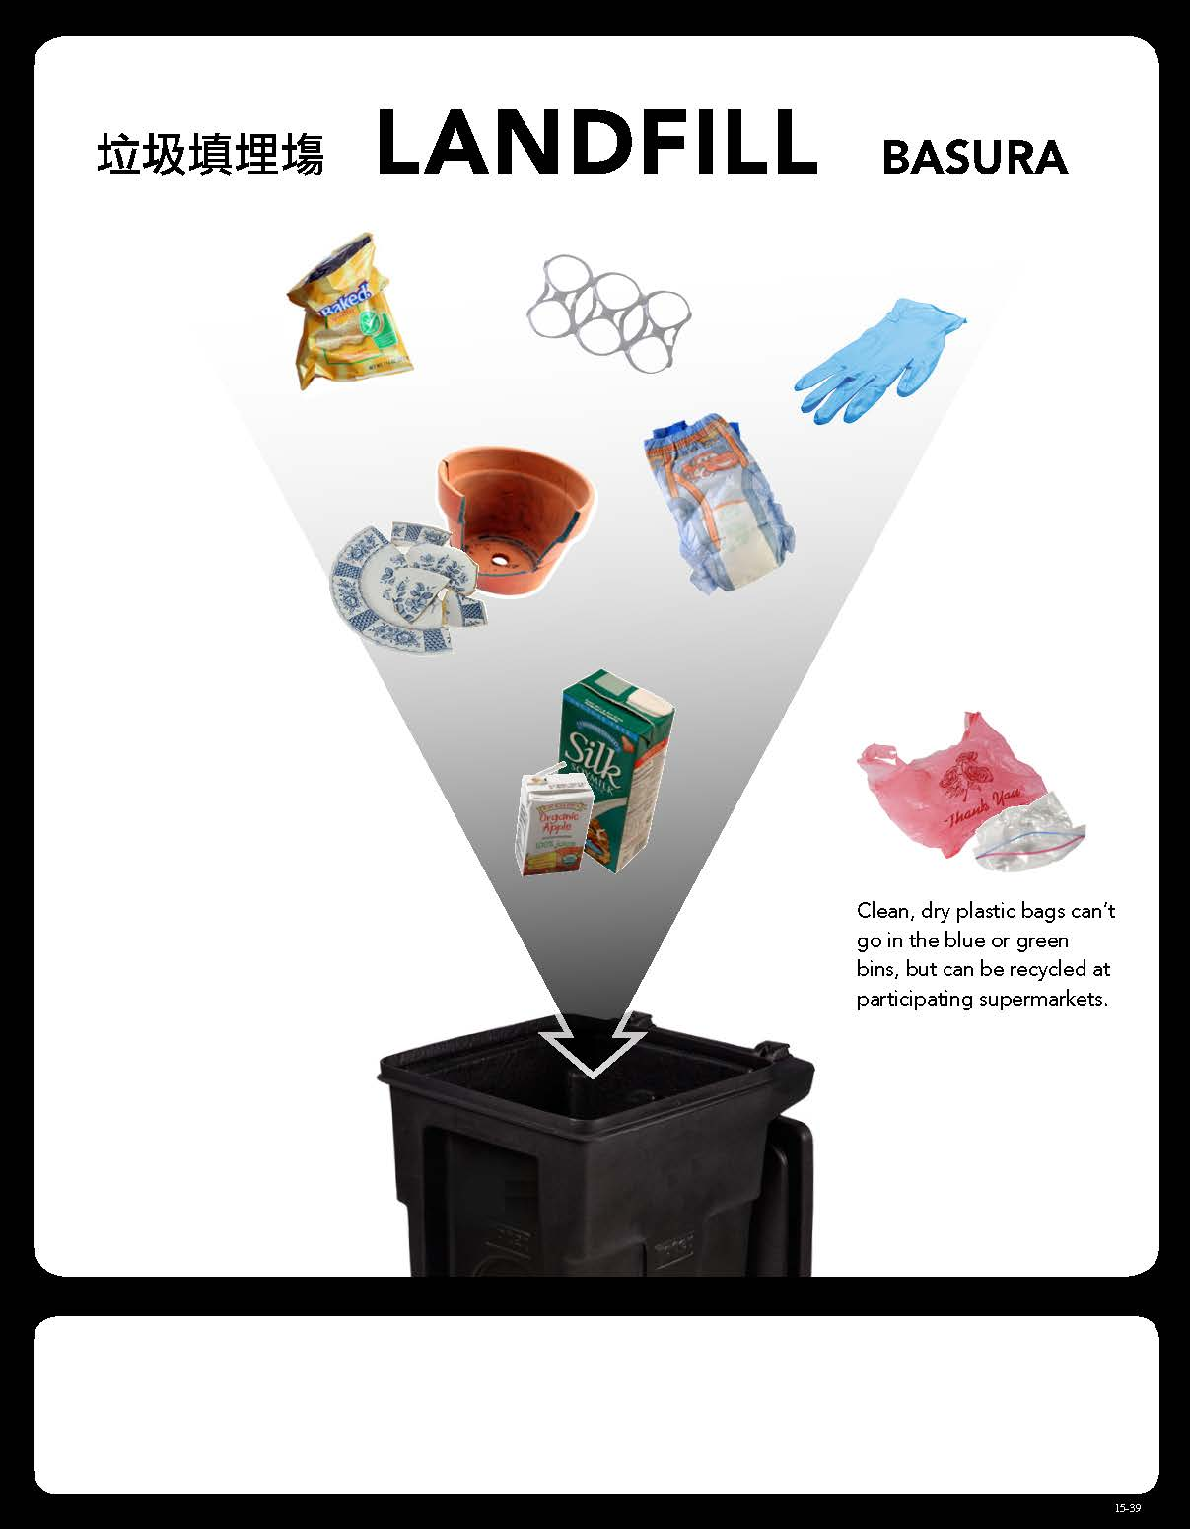
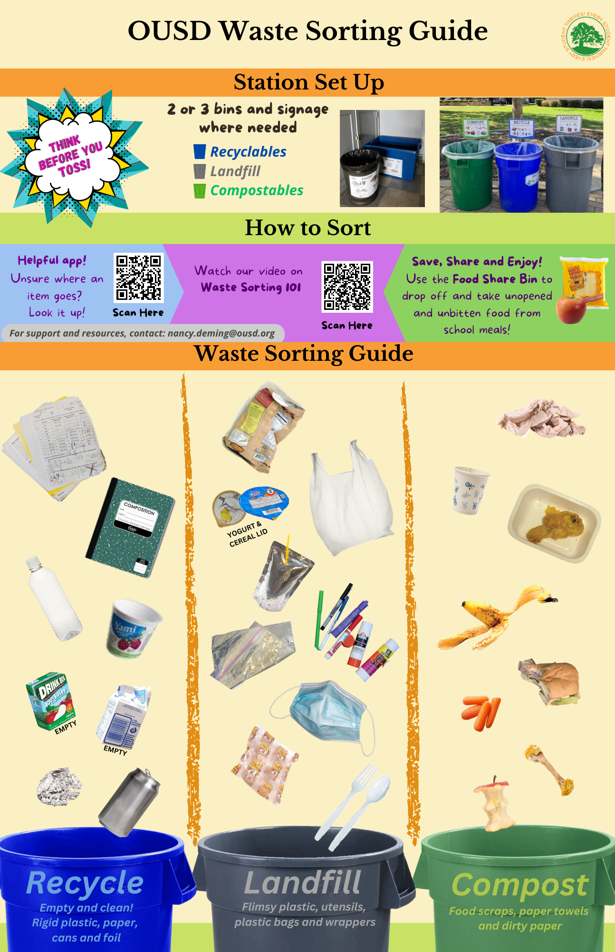
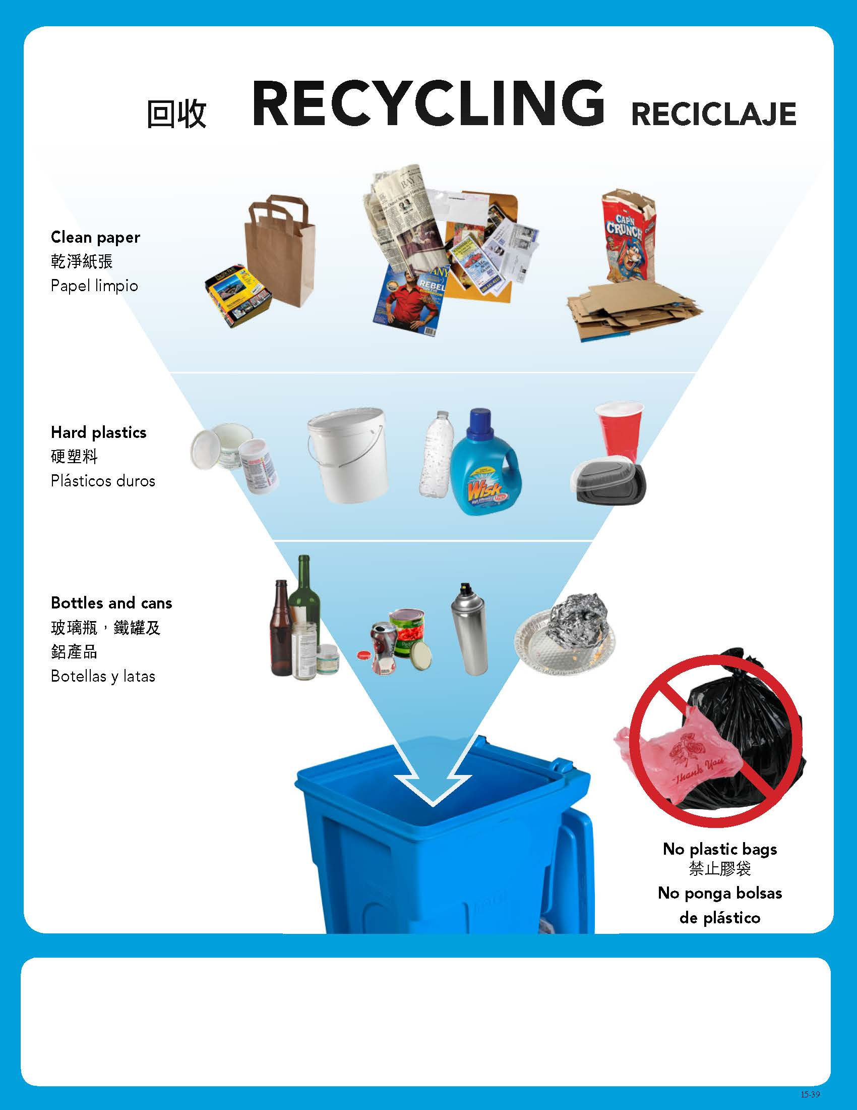
Waste Sorting Posters
To be posted in respective areas

Slide 7
Campus Posters

Slide 8
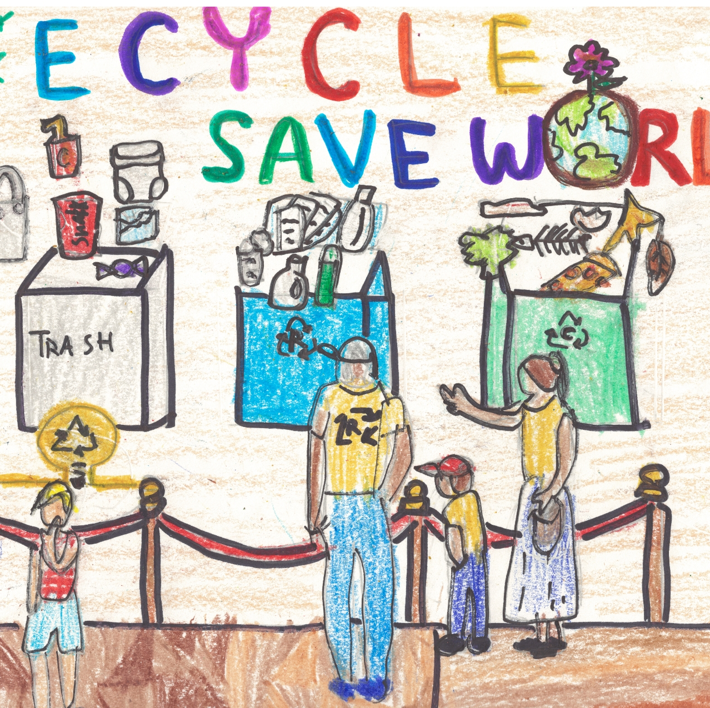
Launching a School Green Team
Student Monitor Training Video (StopWaste)
How to Sort Cafeteria Waste (StopWaste)
Student Monitor Application
Student Team Badges
Supply Guide
For more resources click here!
Photo Courtesy of OUSD

Slide 9
Disclaimer
This guidance tool was developed by CalRecycle as a courtesy for informational and example purposes only. Use of this tool is optional and is not a regulatory requirement. In the event of any conflict with this guidance tool or information herein, applicable statutory and regulatory provisions shall control. This tool and information herein are based on known facts and legal authority as understood by CalRecycle at the time of release. Any analysis, guidance, or other information herein may be subject to change based on changed facts or legal authority, actual or understood, subsequent to the time of this communication. The provision of this guidance tool and any analysis, guidance, or other information herein shall not be construed as a waiver of any rights or remedies available to CalRecycle. Recipients of this communication are encouraged to seek the assistance of legal counsel to comply with applicable state law based on their pertinent facts and circumstances. CalRecycle makes no representation that use of this tool will ensure compliance with regulatory requirements. The user assumes all risk and CalRecycle accepts no responsibility or liability to any person because of the use of, or reliance upon, this tool or the information herein.
Notes:
This concludes my presentation and we will open it up for questions.

